Slide 1




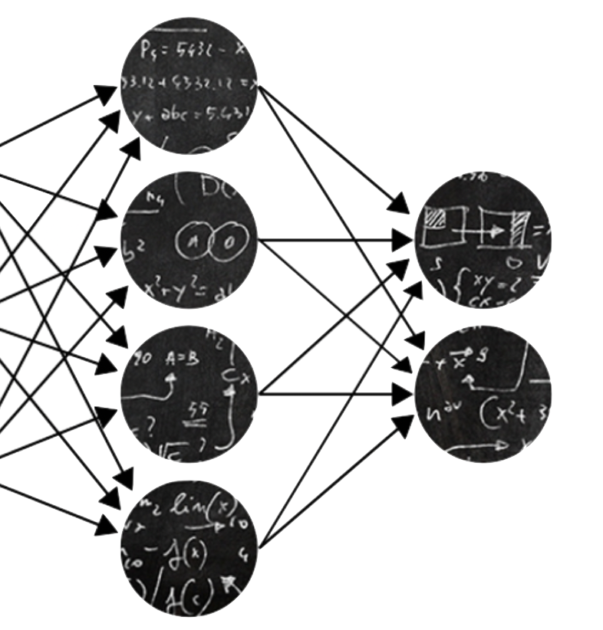
C-3PO: Towards Rotation Equivariant Feature Detection and Description
Piyush Bagad* Floor Eijkelboom* Mark Fokkema*
Danilo de Goede* Paul Hilders* Miltiadis Kofinas

Slide 2
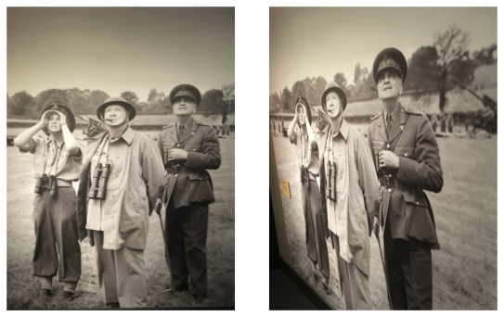
Local Feature Matching: A quick recap!
Source
Target
Input: Pair of images!

Slide 3
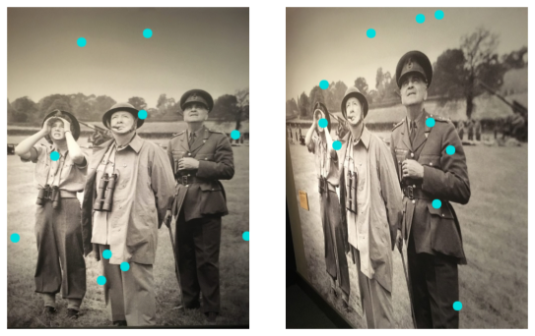
Local Feature Matching: A quick recap!
Step 1: Detect “key-points”

Slide 4
Local Feature Matching: A quick recap!
Step 2: Describe “key-points”

Slide 5
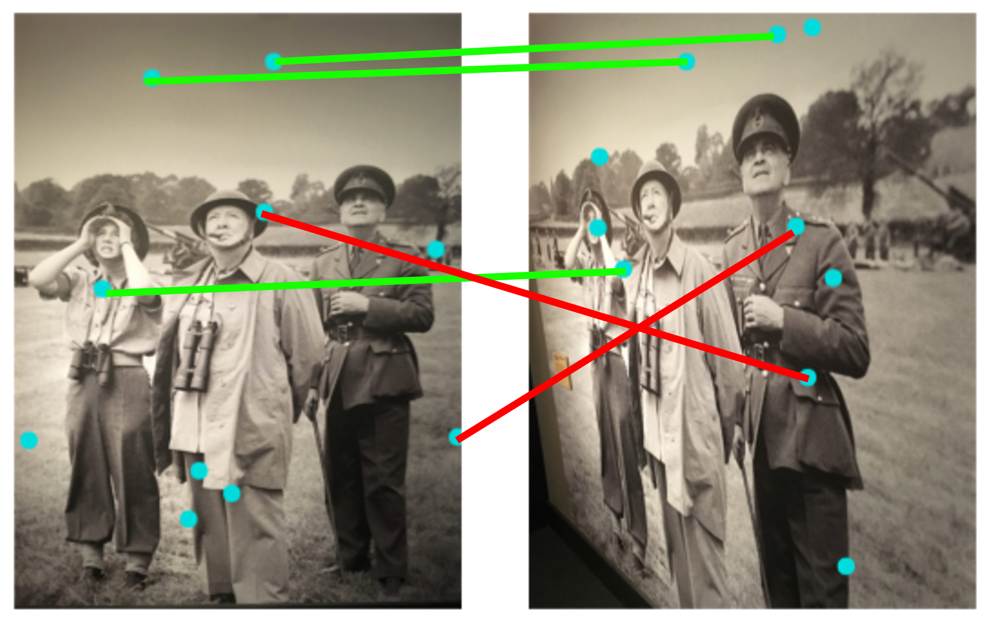
Local Feature Matching: A quick recap!
Bad match!
Good match!
Step 3: Match!

Slide 6
Challenges
Handling affine distortions, for e.g., rotations

Slide 7
Challenges
Handling affine distortions, for e.g., rotations
An existing model with no rotations

Slide 8

Challenges
Handling affine distortions, for e.g., rotations
An existing model with 90$°$rotation

Slide 9
Challenges
Handling affine distortions, for e.g., rotations
- This is critical for tasks such as object tracking, image stitching, computer vision for satellite images!

Slide 10
Challenges
Handling affine distortions, for e.g., rotations
Inherent local nature of the task!

Slide 11
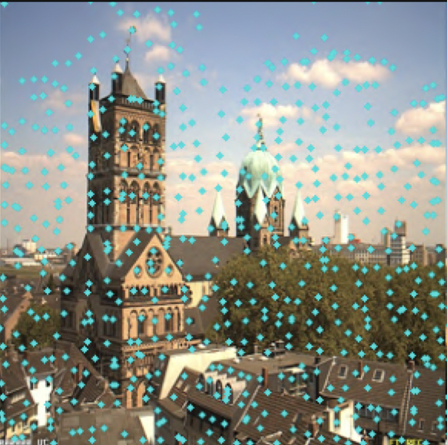

Challenges
Handling affine distortions, for e.g., rotations
Inherent local nature of the task!
Pixel values around may be very different due to interpolation artifacts!

Slide 12
Prior Work
Existing methods based on deep networks (e.g., R2D2) have shown promise in learning to detect and describe key-points
However, most methods use data augmentation for rotation-invariance
Does not guarantee invariance
Introduces redundancy in learnt features
Applies to the whole network caring about priors over each layer

Slide 13
Our Proposal in a Nutshell
Why don’t we try and make the feature matching architecture itself invariant to rotations?

Slide 14
Background: R2D2
Key insight: good key-points should not just be repeatable but also reliable
Notes:
Repeatable: if the same patch occurs elsewhere, does it have the same feature?
Reliability: is a region reliable for matching?

Slide 15
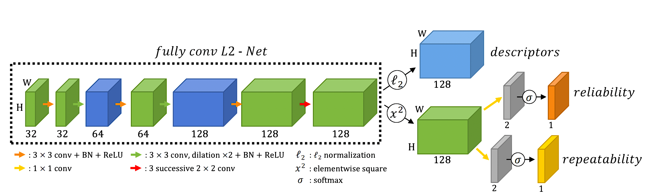
Background: R2D2
Key insight: good key-points should not just be repeatable but also reliable
Convolutional Layers
Notes:
Repeatable: if the same patch occurs elsewhere, does it have the same feature?
Reliability: is a region reliable for matching?

Slide 16
Our Proposal
Can we directly inject geometric priors to a deep detect-and-describe model?

Slide 17
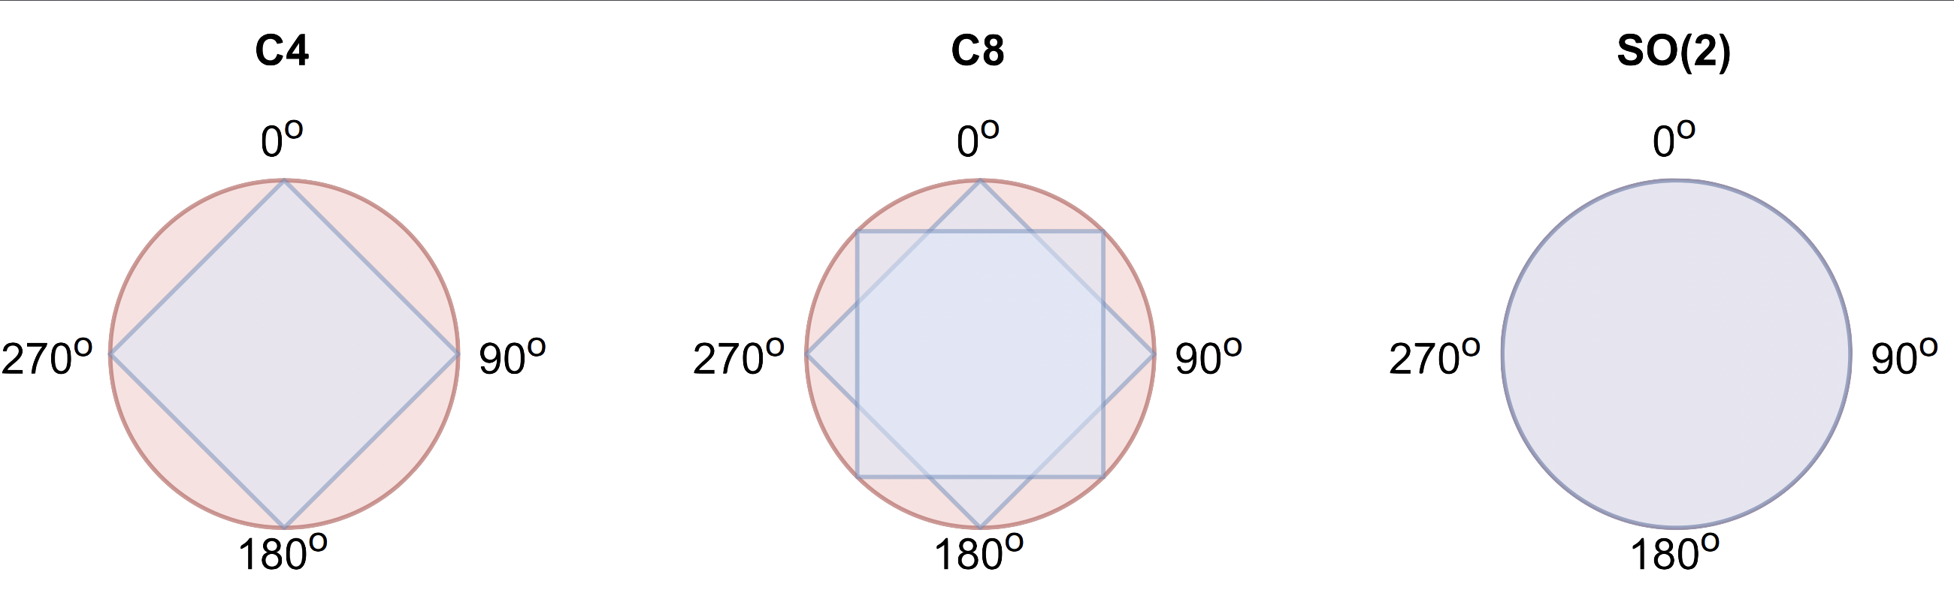
Detour: Group-equivariance in CNNs
Key groups

Slide 18
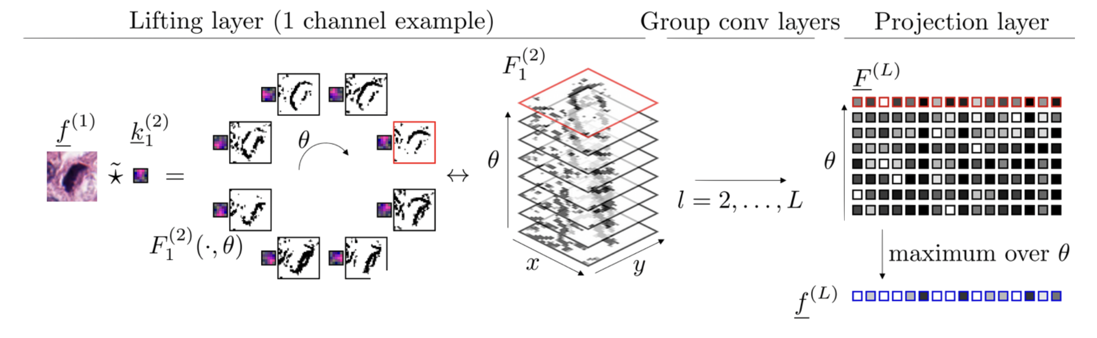
Detour: Group-equivariance in CNNs
Image credits: Erik Bekkers, Group Equivariant Deep Learning

Slide 19
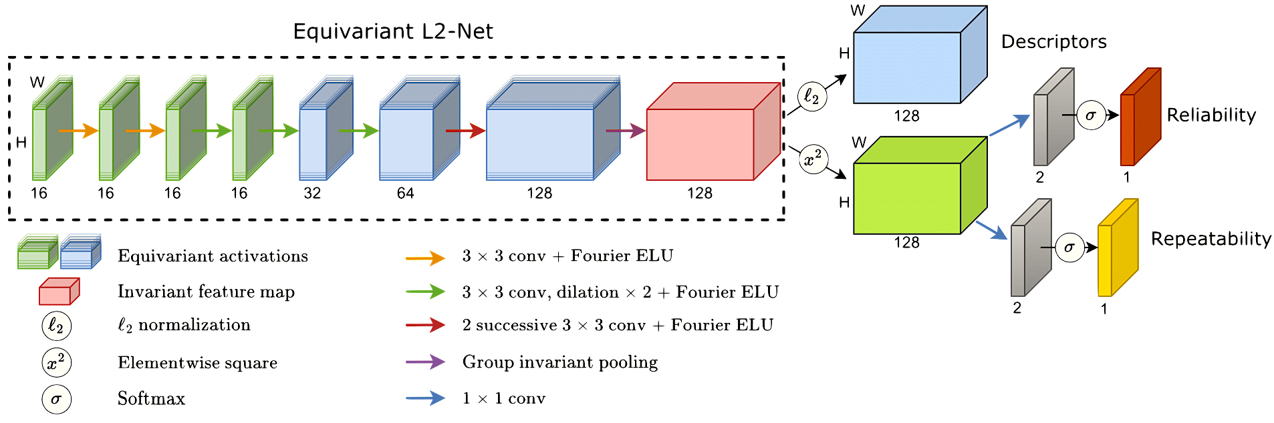
Our Proposal
Convolutional layer → G-convolutional layer

Slide 20
Results: Quantitative

Slide 21
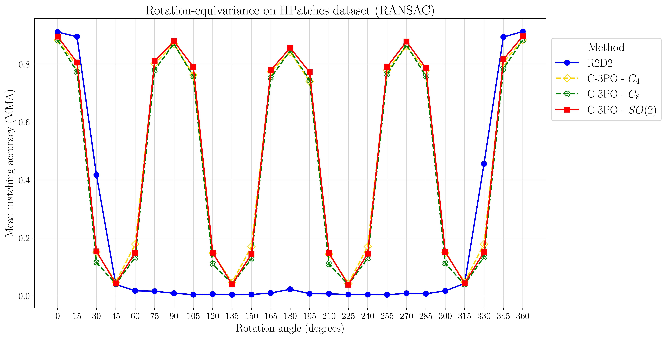
Results: Quantitative

Slide 22
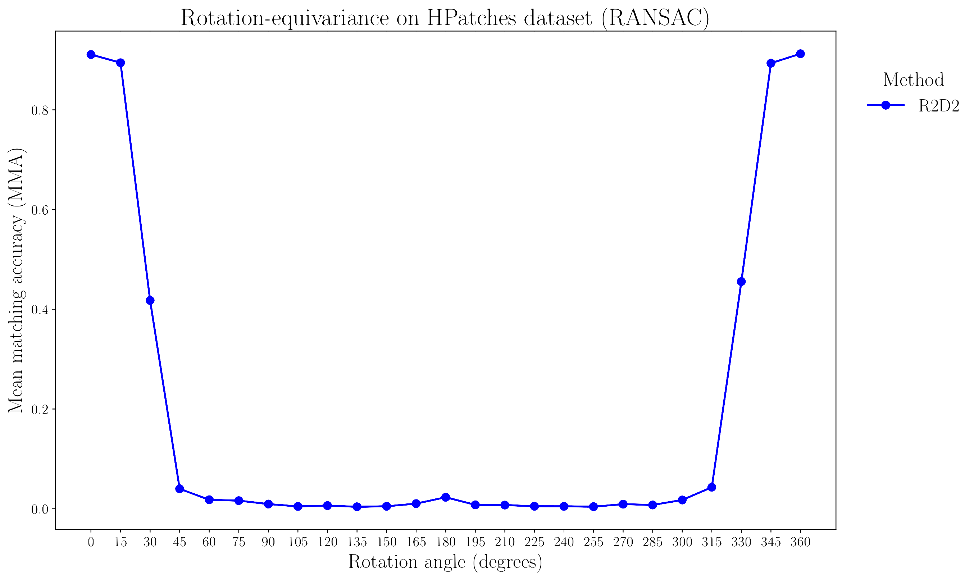
Results: Quantitative

Slide 23
Results: Quantitative

Slide 24
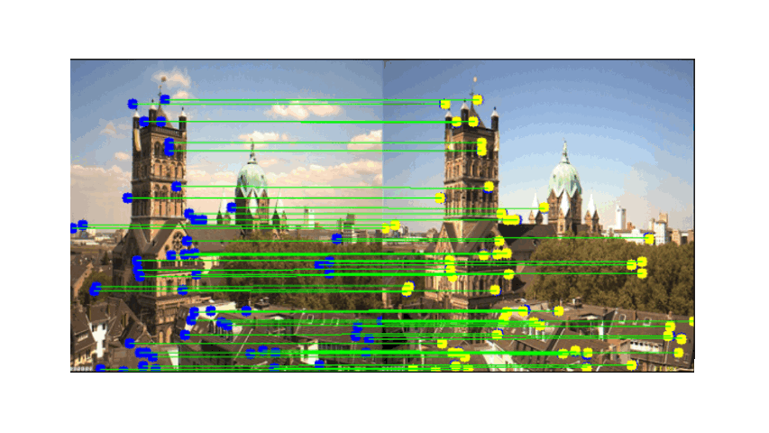
Results: Qualitative

Slide 25
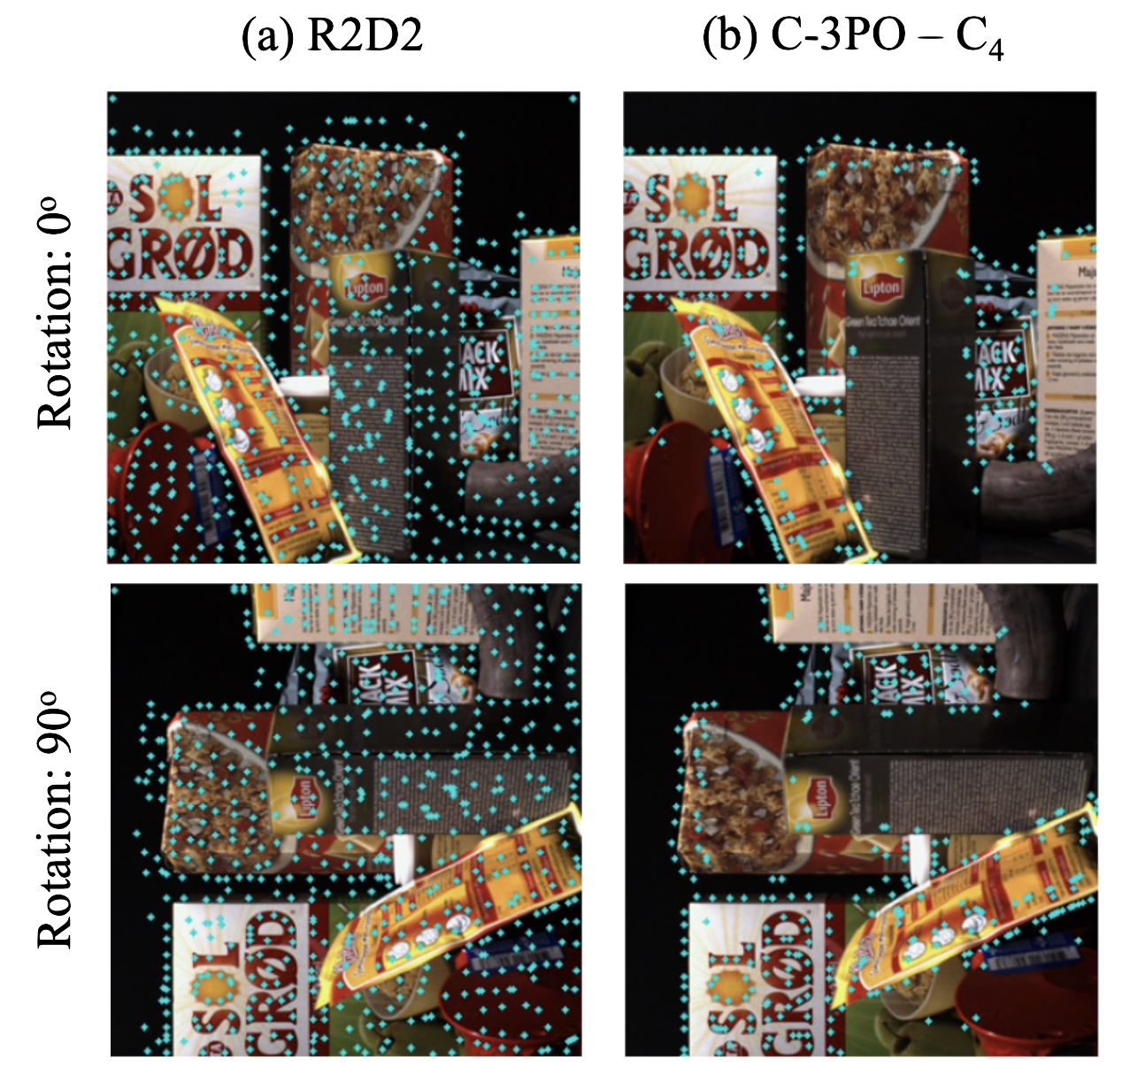
Results: Qualitative
Vanilla R2D2 tends to detect too many key-points
Notes:
We note an interesting pattern that emerges as a result of the introduced priors

Slide 26
Results: Qualitative
Vanilla R2D2 tends to detect too many key-points
Our model variants tend to detect few key-points but those are distinctive to rotations
Notes:
We note an interesting pattern that emerges as a result of the introduced priors

Slide 27
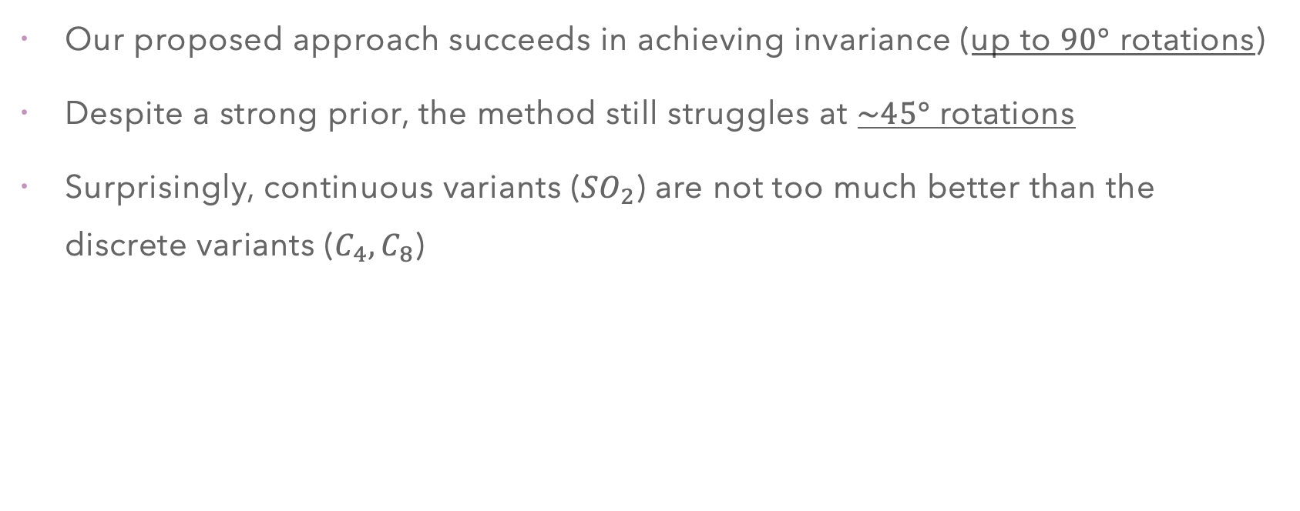
Key Highlights
Our proposed approach succeeds in achieving invariance (up to $90°$ rotations)
Despite a strong prior, the method still struggles at $\sim 45°$ rotations
Surprisingly, continuous variants (${SO}_{2}$) are not too much better than the discrete variants ($C_{4},C_{8}$)

Slide 28
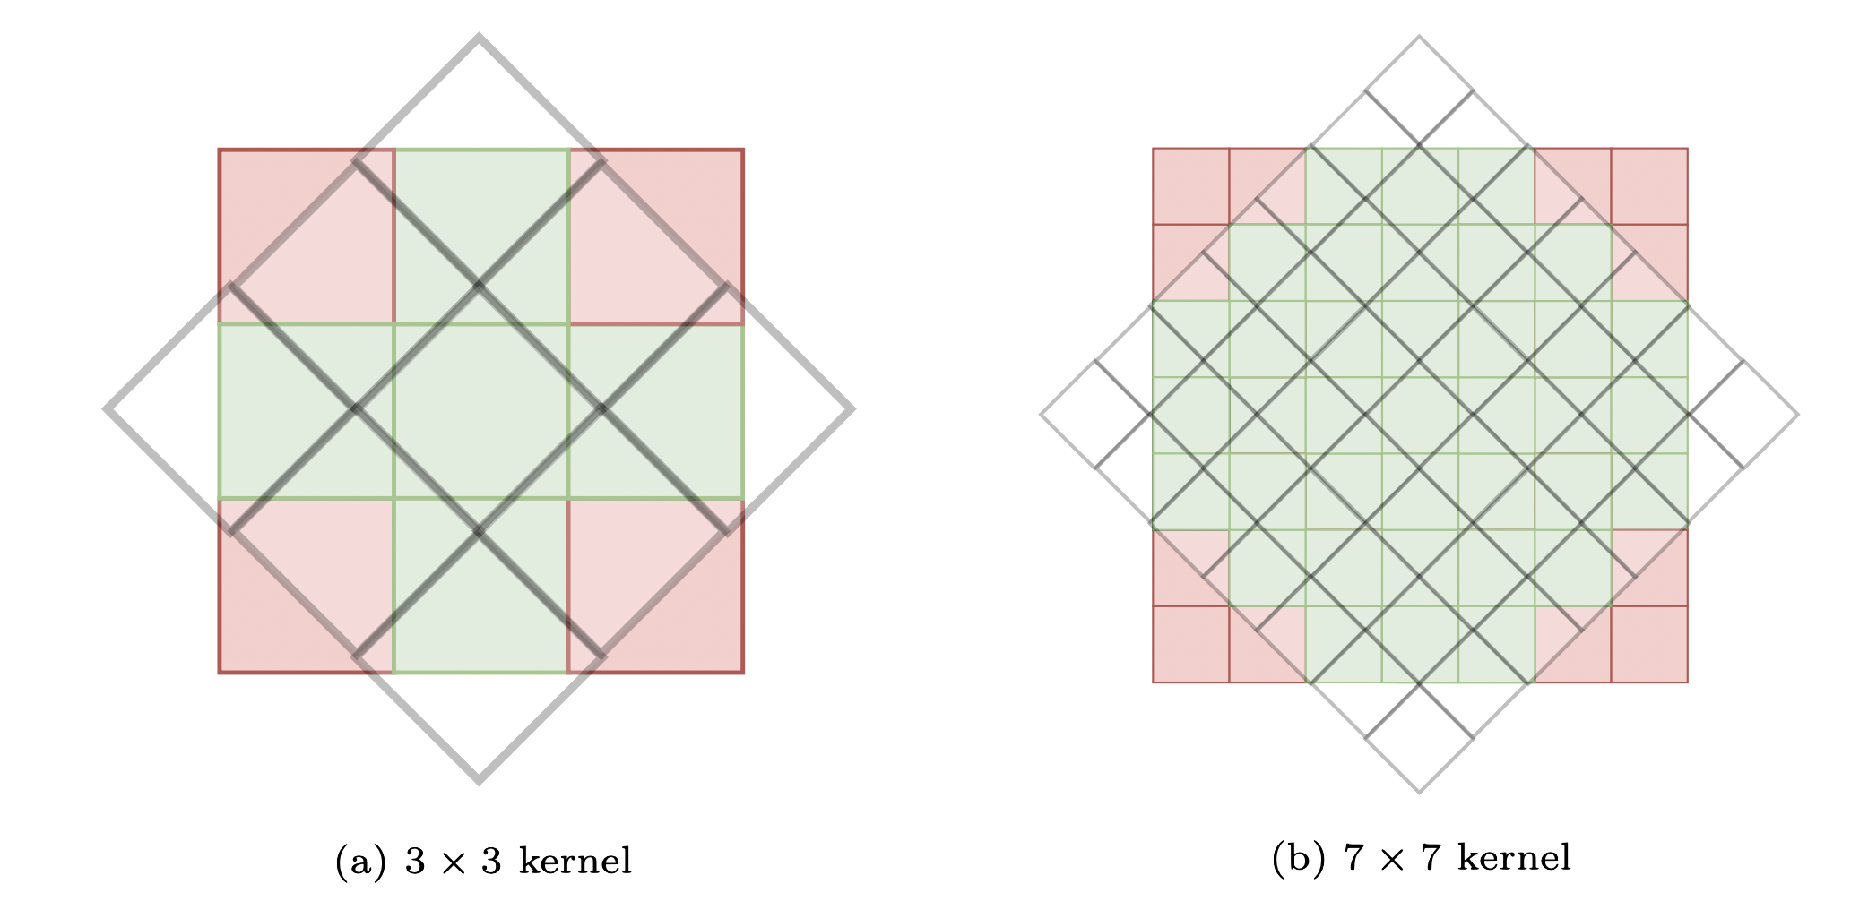
Limitations & Future Work
Rotation-equivariance priors come at a significant computational cost!
Our study is restricted to use the R2D2 backbone but other recent ones can be experimented with!
In the future, we’d like to investigate
Why do continuous variants not outperform discrete ones?
Using larger kernels?
Using different interpolation techniques?

Slide 29

Thanks!
Questions?

